Slide 1


Farm Grid
Let’s Farm Smarter.

Slide 2
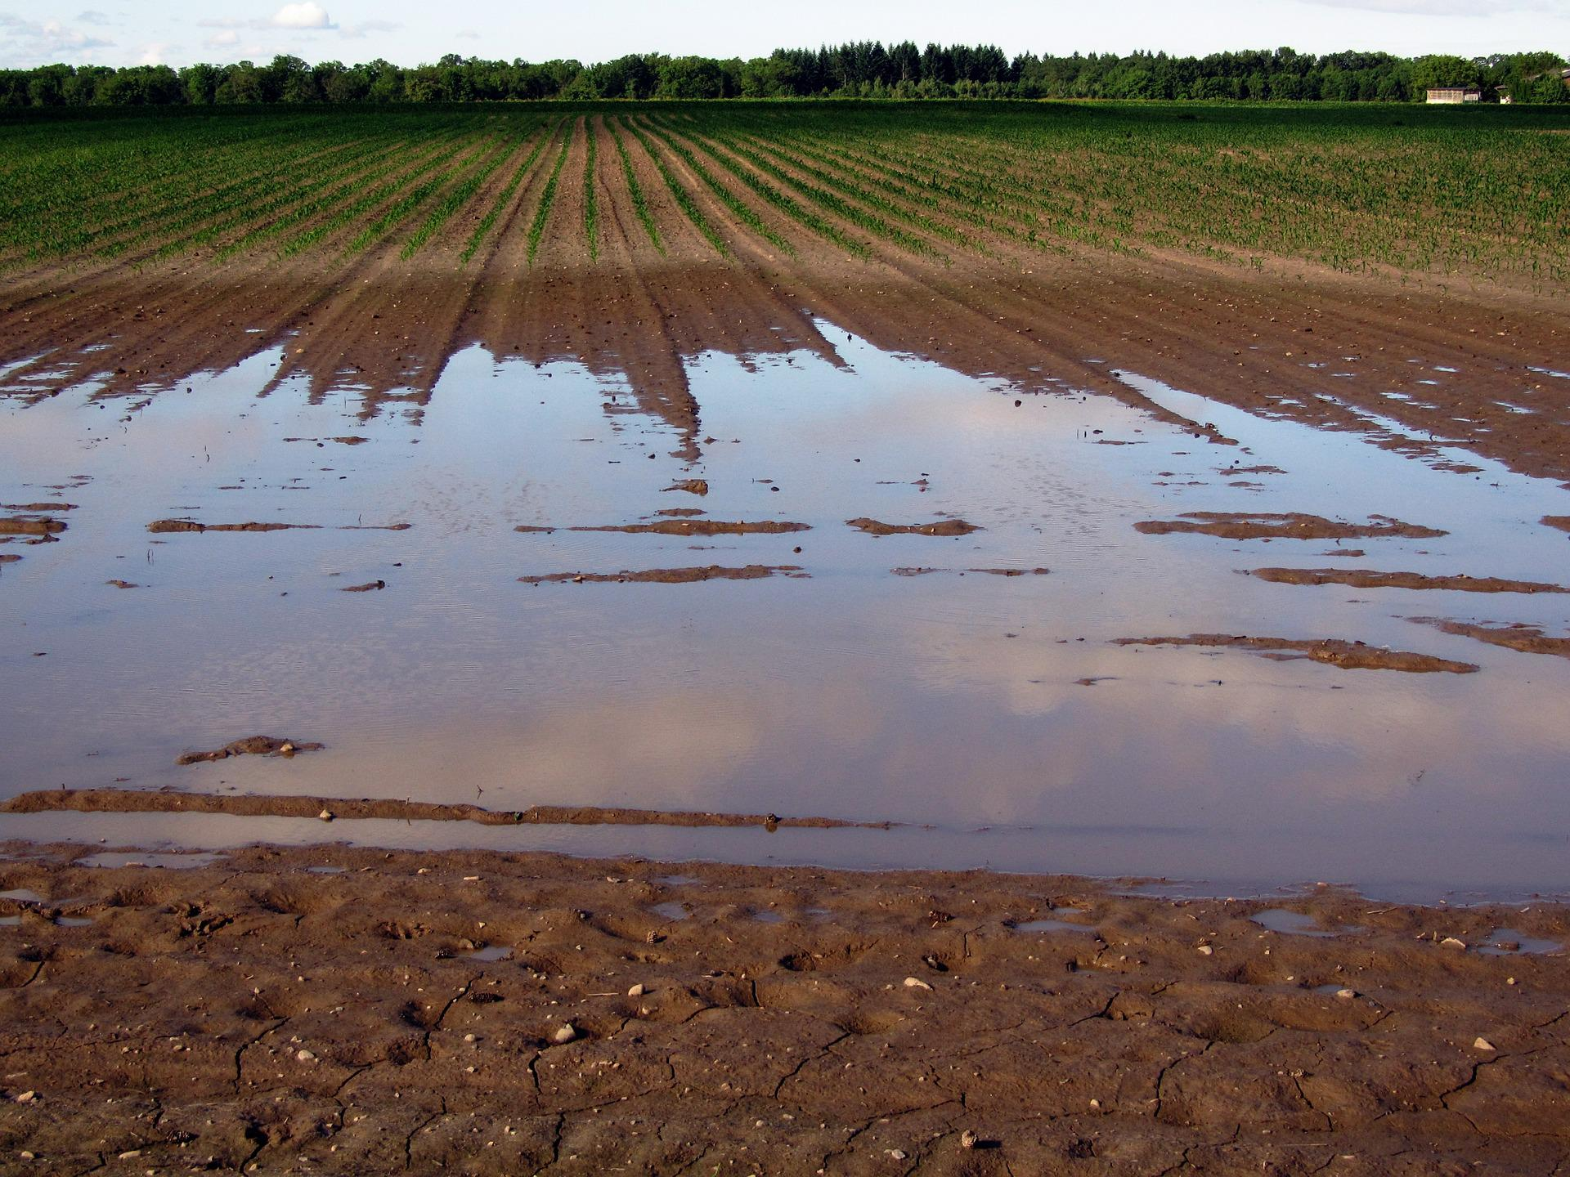
Trillions of Water Wasted.
Billions Need Food by 2050.
Approximately 800 trillion gallons of water are wasted globally in agriculture. Water is often spread evenly on a field because it is difficult to measure how much is needed and where.
The world population is estimated to reach 9.8 billion people by 2050. Farm productivity must improve to meet the food demand, and resources must be used efficiently.
Precision agriculture is a $6.8B global market, yet there are few intuitive low-cost solutions for 50% of the U.S. market: family-owned farms*.
*Farms with <$10,000 gross income – USDA Study
Wasted water on a field kills crops and increases operating expenses for small farms by $7,500 on average.

Slide 3
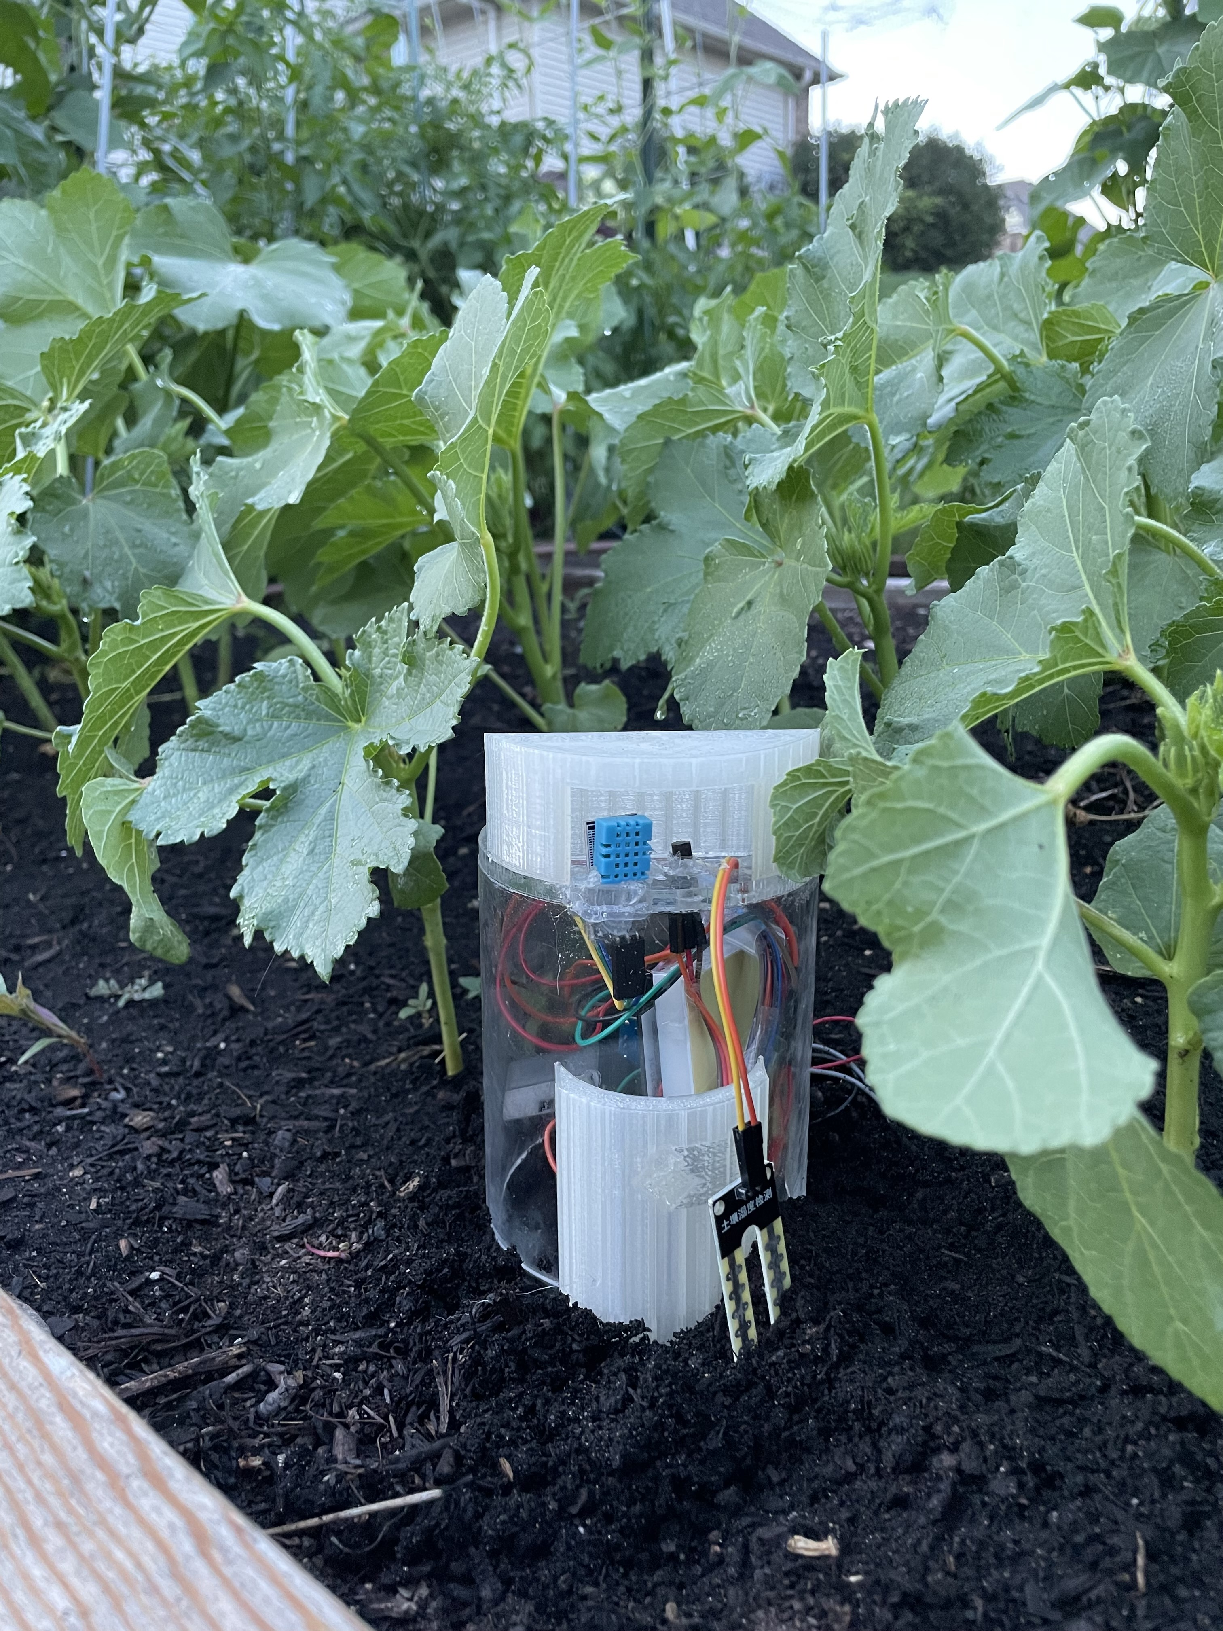

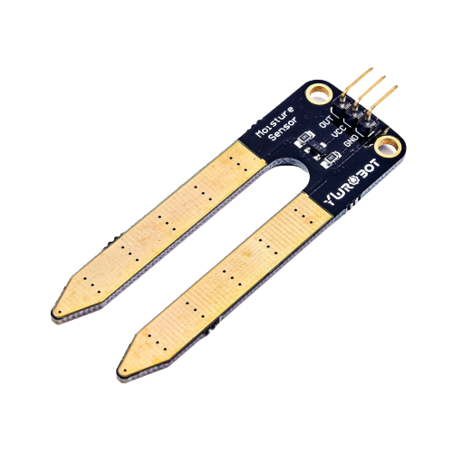
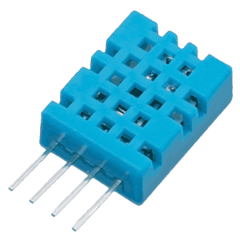
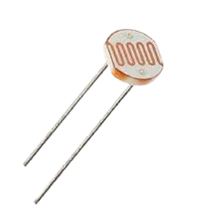
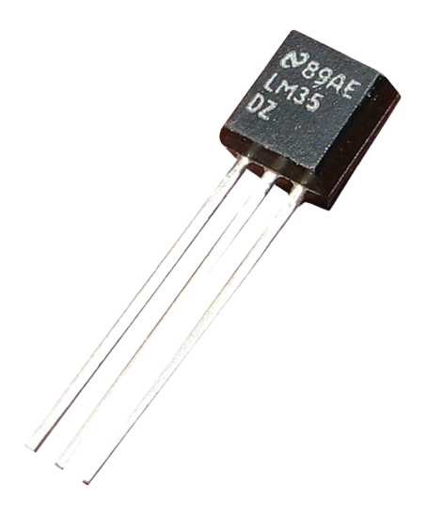
FarmGrid closes the gap between farmers and technology…
…Sustainably
…Intuitively
FarmGrid’s patent-ready & energy-saving design publishes sensor data on automated cycles while running completely on solar power.
No need for battery changes or maintenance - simply turn the device on and place it outside. Out custom-designed water-tight enclosure protects against the elements.
Our device comes with:
Temperature
Soil Moisture
Humidity
Light

Slide 4
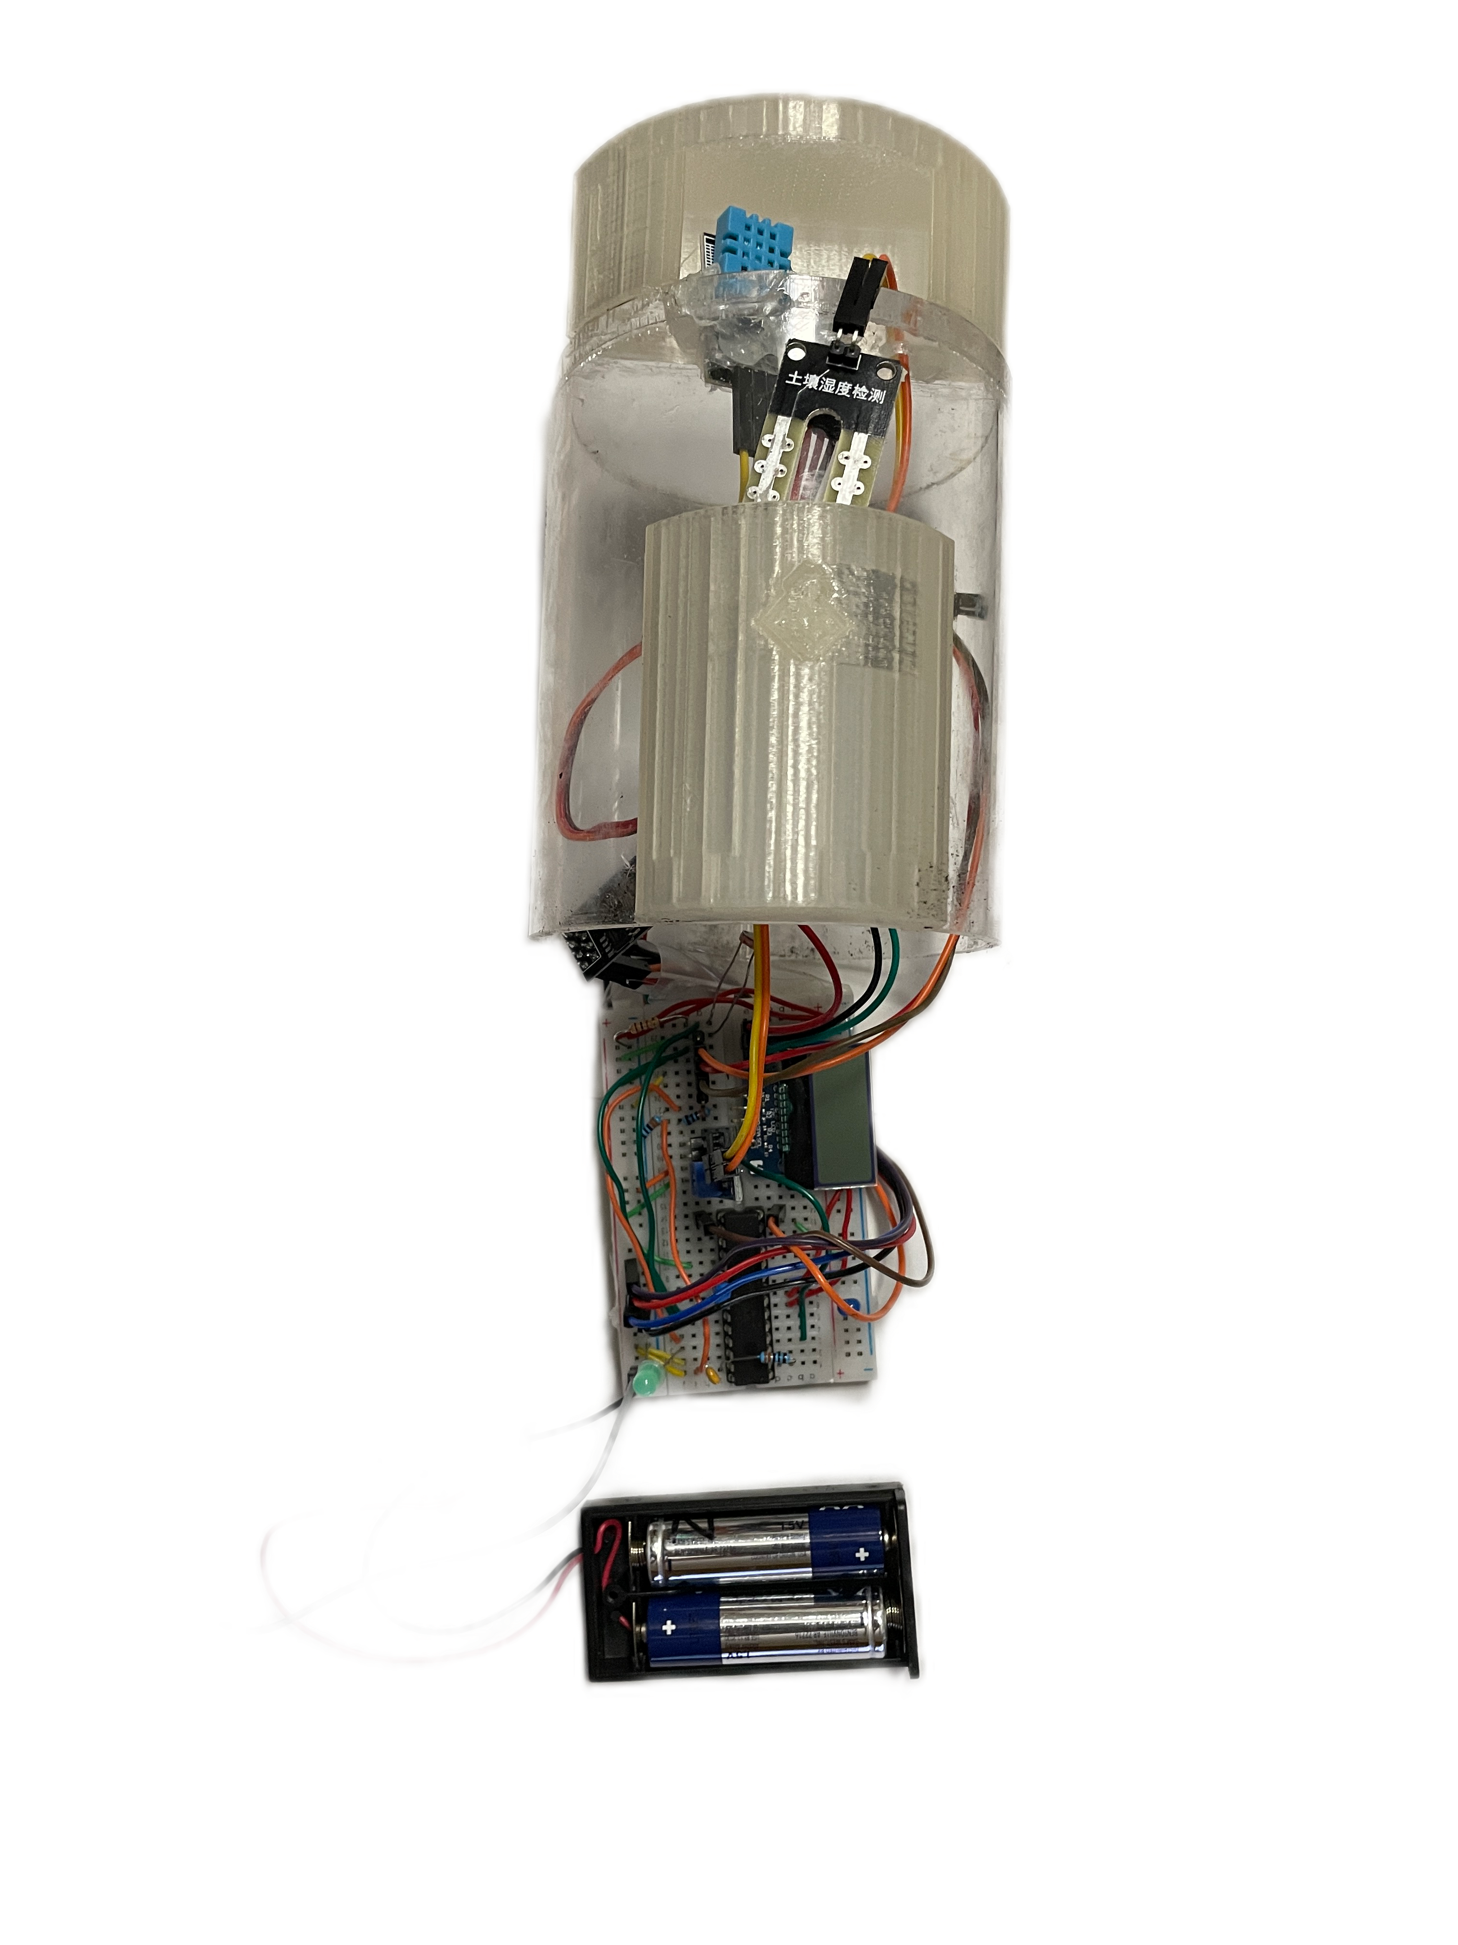
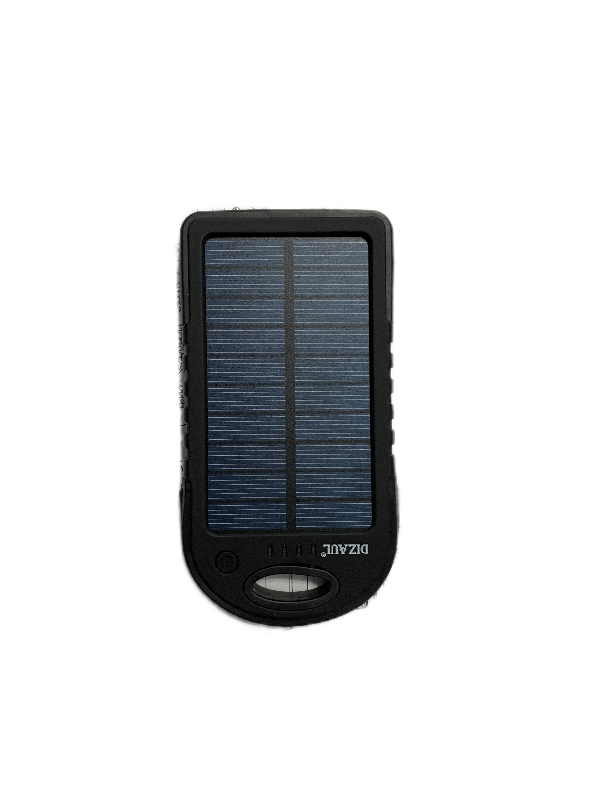
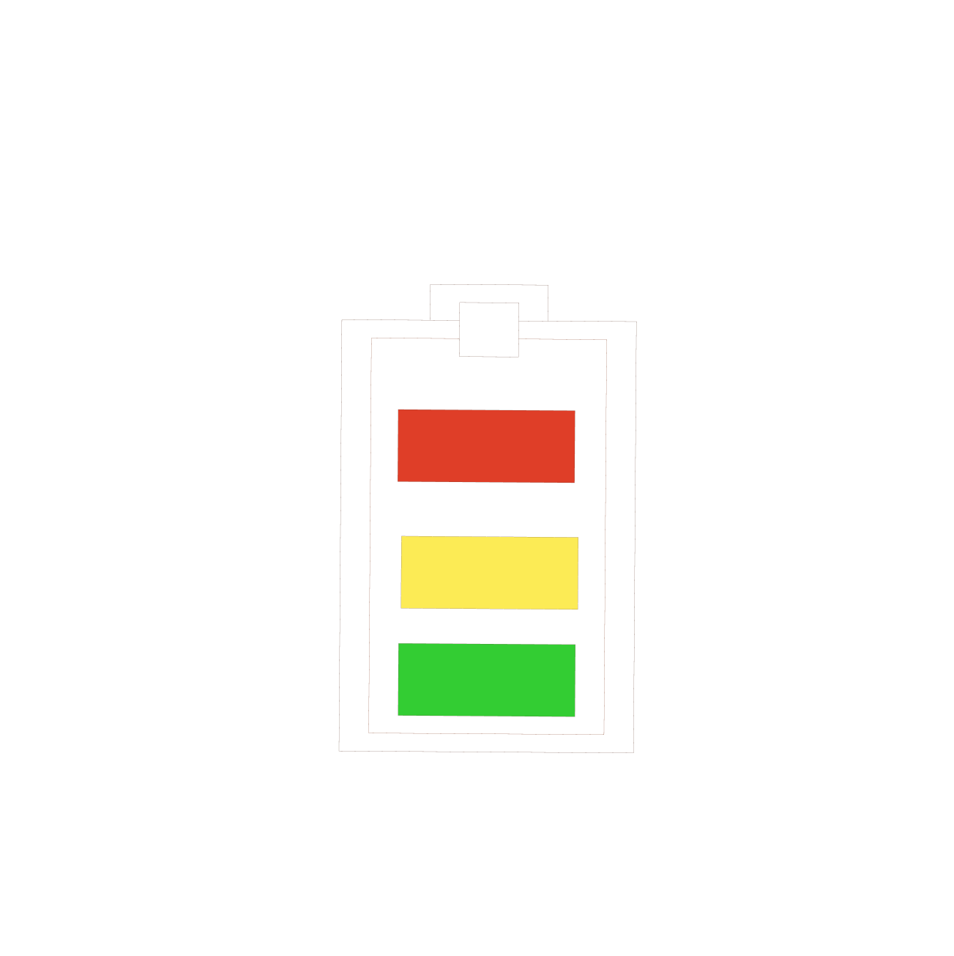
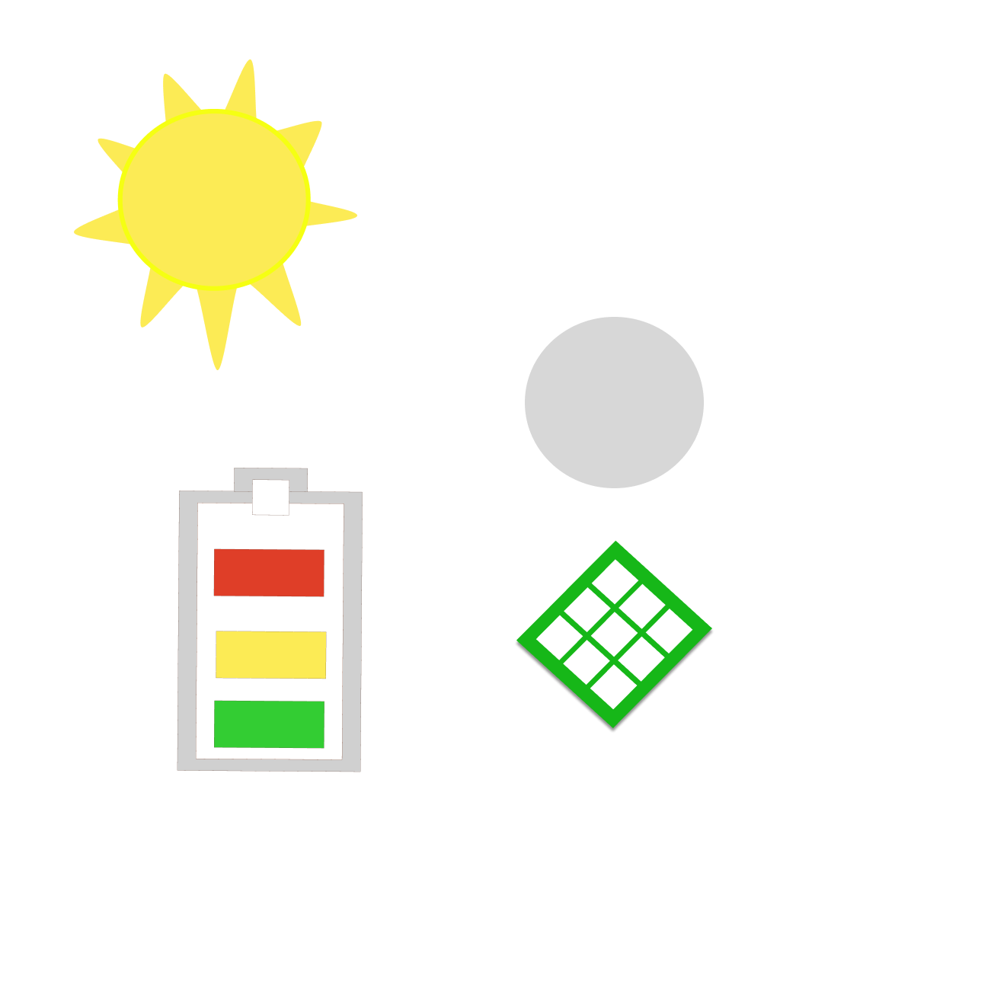
Self-charging Battery
Custom Raincover
Weatherproof Plexiglass
Off-the-shelf Electronics
Our Wireless Sensor Device.
Our wireless sensor is lean and customizable to our client’s needs, driven by extensive insights gathered from hours of research and speaking to students who worked on Midwest farms.
We learned quickly that farmers want results and are risk adverse to technology created just for the sake of it. FarmGrid’s design uses pure off-the-shelf parts (no pre-made costly Arduino!) for a cost-effective wireless sensor that connects to the internet quickly and works.

Slide 5
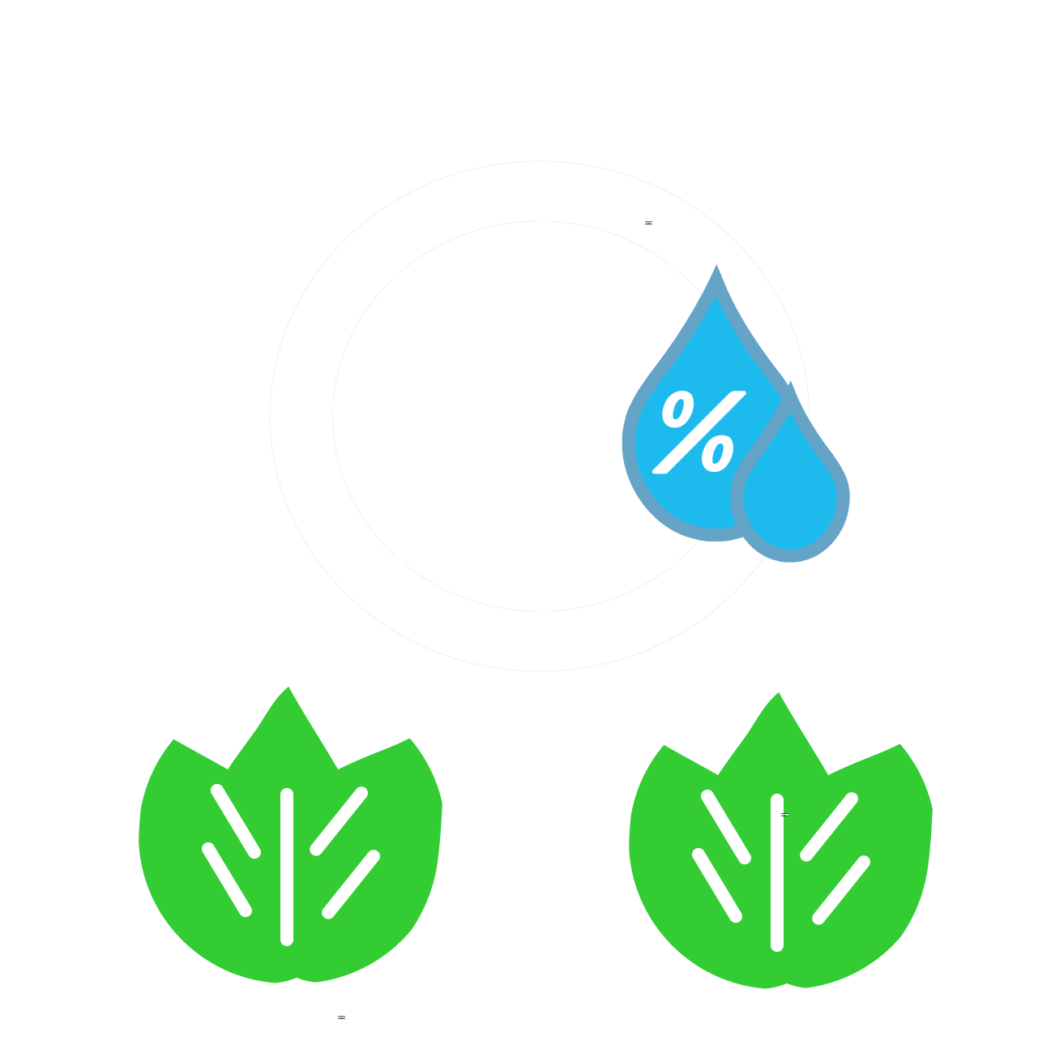


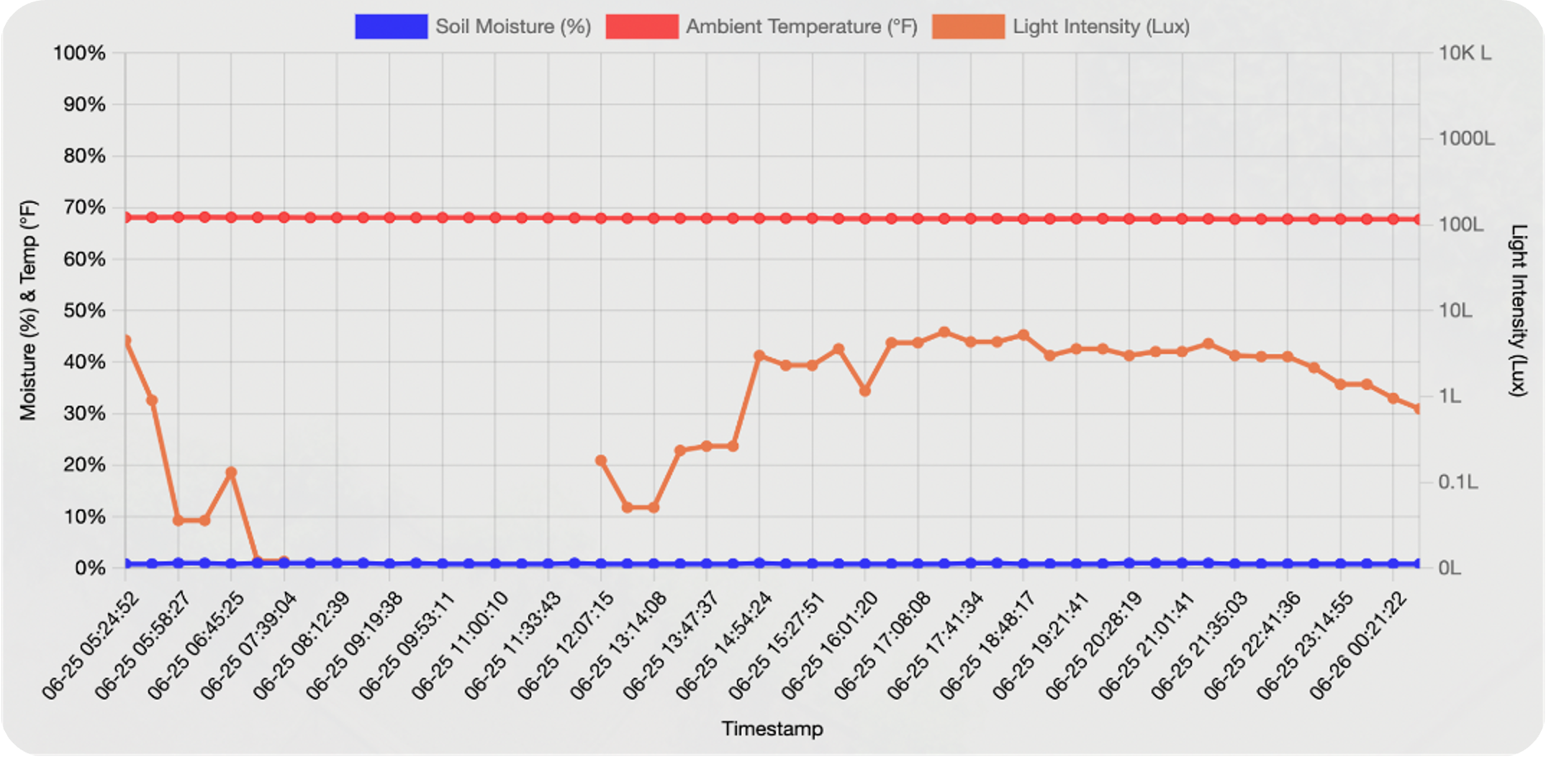
A Dynamic Remote Software:
Our user-interface dynamically updates and plots incoming data so farmers don’t have to.
Accessible from anywhere in the world – simply login to your account on our website to access the dashboard.
Our user-interface is scalable – the databases we manage are ready to accumulate data from a variety of gardens, fields, and weather conditions, so we can offer advanced insights using machine learning.
When the soil moisture at a point on the field gets too low, our user-interface will let farmers know visually through a notification letting them know where on the field and when.

Slide 6

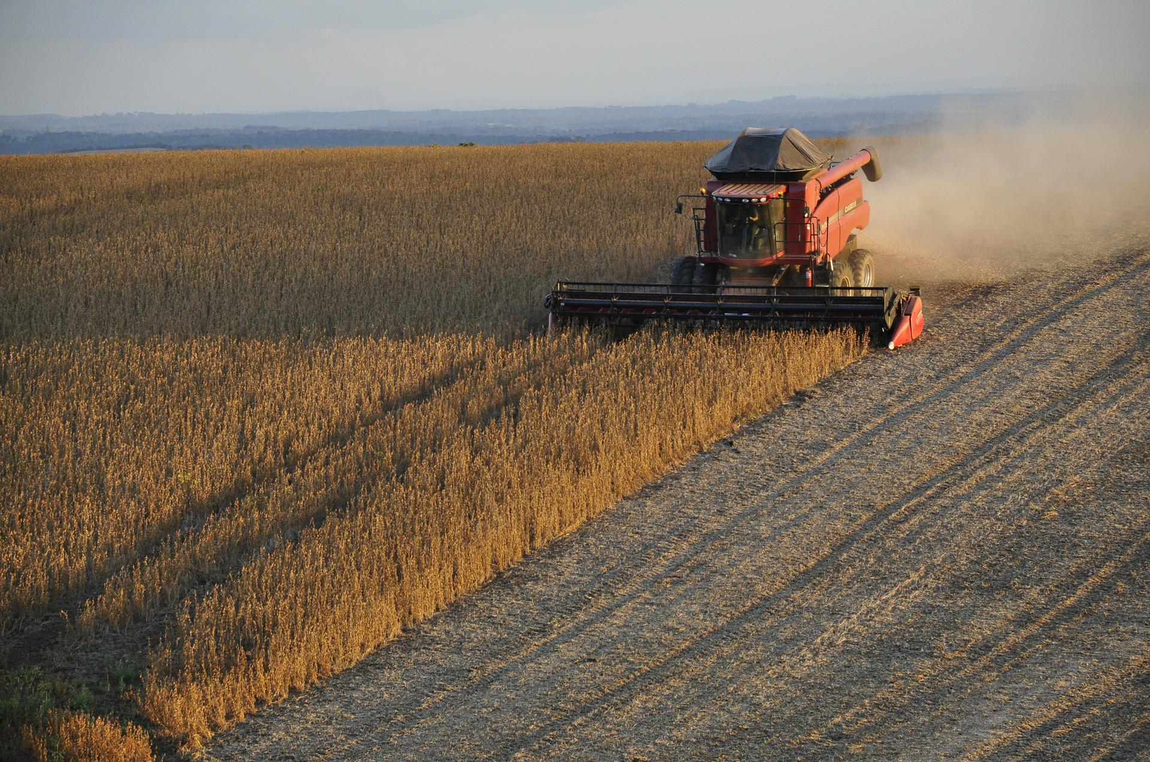


Leading Competition Failed.
Leading companies currently offer sensors attached on harvesters, self-driving tractors, and drone-based crop-mapping.
Here’s why these strategies fail.
Infrequent Measuring – drones and harvesters give little clarity on how the field changes overtime since they won’t be out there all day.
Human Supervision – farmers still need to supervise their drones and self-driving tractors, even if they’re doing so remotely.
Automation = $$$ – crop-mapping drones cost $2,000 to $5,000 on the low-end, while automated vehicles are $10,000 or more. Renting solutions are inconvenient, infrequent, and non-passive.

Slide 7
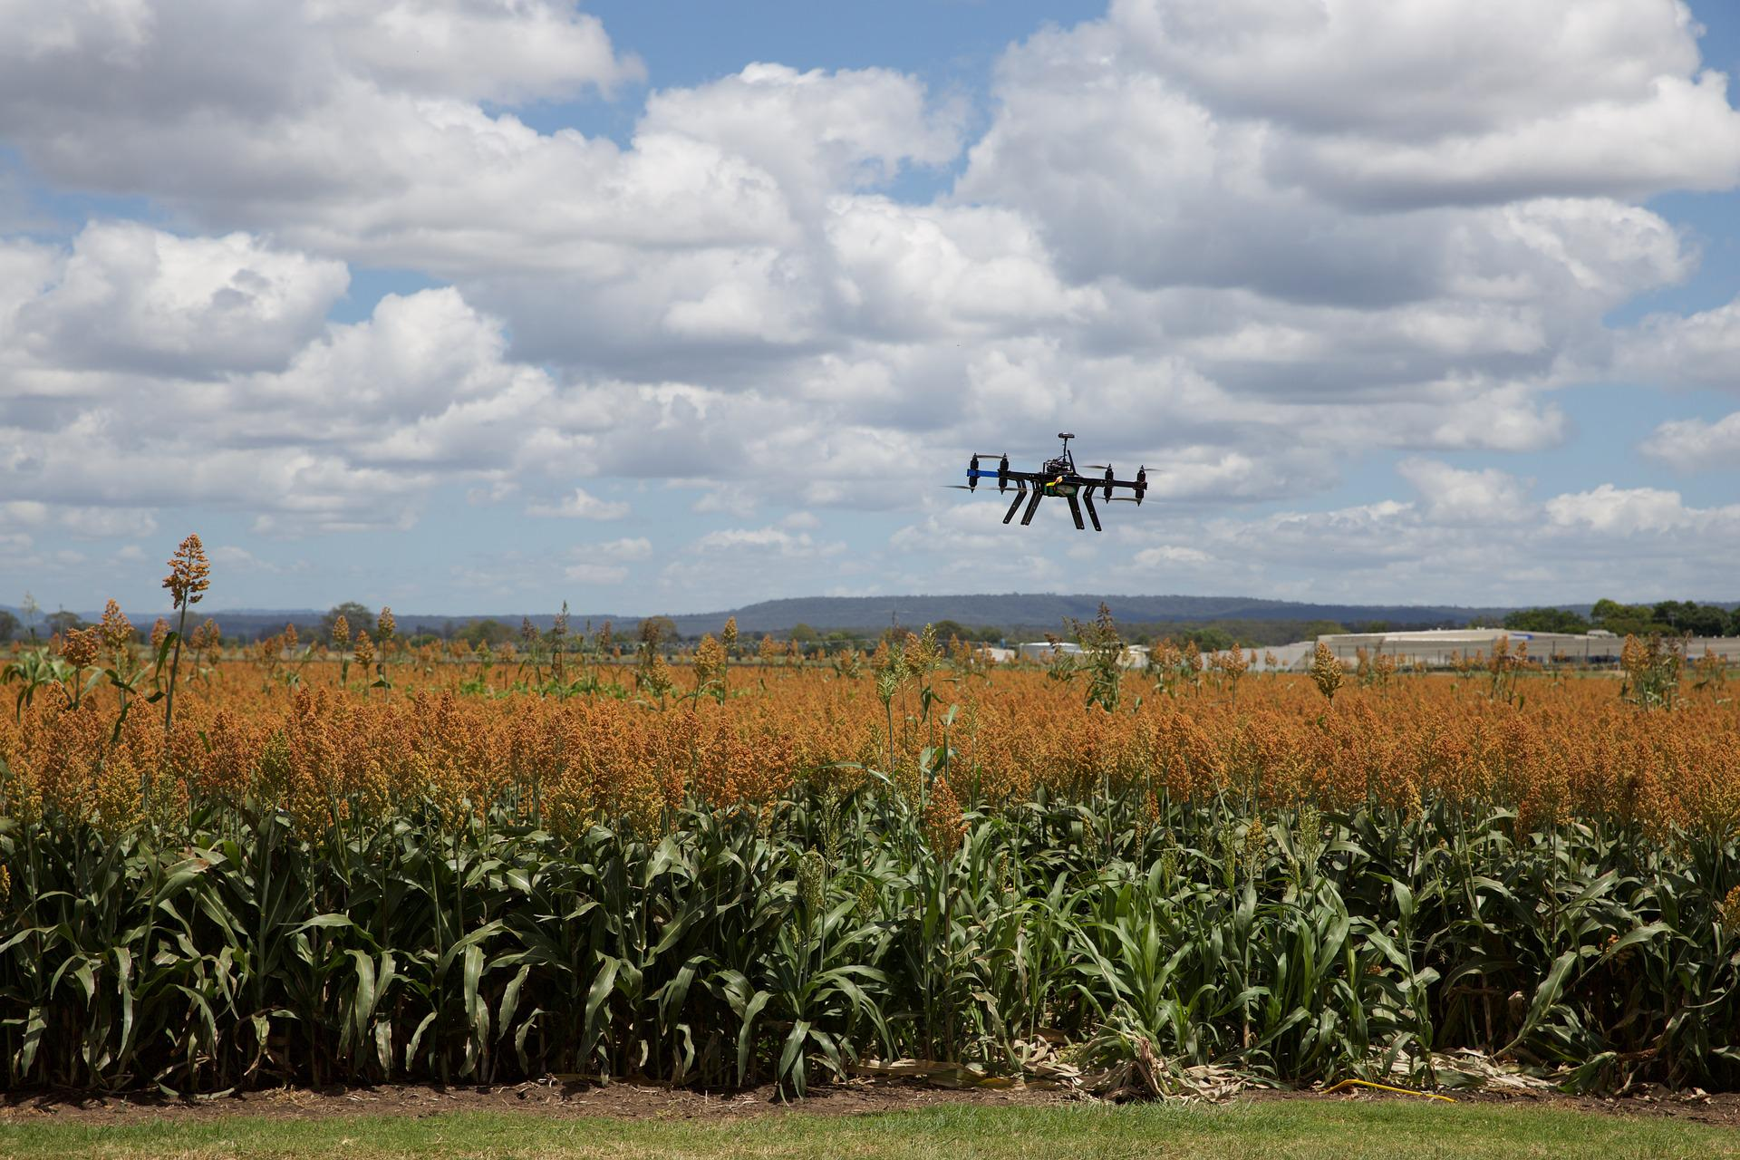



The Focus is Elsewhere.
Our closest competitors offer wireless sensors with heavy disadvantages for small farmers.
Here’s why.
The Cost – average industrial grade soil moisture sensor costs $150-$270 per unit, while wireless sensors can cost $250 or more.
Tech Proficiency – sensors assume technology proficiency to install, such as positioning the sensors correctly and installing batteries.
Require Multiple Routers – for large fields, our competitors require farmers to get multiple routers, so the furthest sensor can connect to the internet.

Slide 8
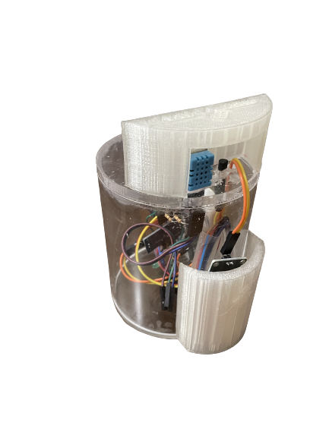
Why FarmGrid Will be Effective.
Water management is both a sustainability and an intuitiveness problem – water usage is not efficient enough while current solutions are costly and require technology proficiency. FarmGrid’s solution tackles both, as we:
Don’t assume technology proficiency – farmers simply turn on and place the sensor on the field, no battery replacement required as device runs on solar energy.
Don’t require multiple routers on large fields – we are working on a wireless sensor network so devices can route data between themselves if no WiFi is nearby.
Plan to sell our sensors at $50/device, which is at least a third of the cost of the lowest priced wireless sensors on the market.

Slide 9

Market Opportunity is Accelerating.
The global precision agriculture market is growing at a CAGR of 12.8%, from $6.96B in 2021 to $11.25B projected in 2025. Our solution will be at the forefront of what’s to come in this space, based on current market trends in wireless sensor networks (WSN’s) and Machine Learning as a service (MLaaS).
Precision Agriculture Market:
We’re Confronting:
$20.54B
MLaaS market by offering ML predictions on where and when water is needed.
$3.7B
$11.25B
$6.96B
WSN market by reducing routers on the field via data routing between our devices.
$29.1B

Slide 10



Massive Opportunity In Plain Sight.
Our product addresses 70% of the precision agriculture market of field-data monitoring and mapping. However, providing solutions for small businesses (close to half the market) is an underutilized opportunity hiding in plain sight. FarmGrid aims to service it.
TAM $13.7B
SAM $7.1B
~$13.7B Total Addressable Market - the global market size of soil moisture monitoring devices .
($8.8B turf/lawn + 70% of precision agriculture market, or $4.9B)
~$7.1B Serviceable Addressable Market - the U.S. market size of soil moisture monitoring devices .
($4.4B turf/lawn + $2.7B agriculture)
~$1.35B Serviceable Obtainable Market – portion of U.S. market segment being small or family-owned businesses.
(Roughly half of $2.7B U.S. precision agriculture).
SOM $1.35B

Slide 11



A Business Model for Everyone.
We’ll use a direct to consumer (D2C) approach early-on because we want to mediate our transactions face-to-face with farmers and help them navigate using the device on their farm. We’ll offer a software as a service (SaaS) model for our user-interface (UI) with AI insights, and a freemium model for the UI on its own so farmers always have end-to-end access .
+
D2C
Freemium
SaaS
$50 one-time fee per device. Includes temperature, humidity, light, and soil moisture sensors
Free access to user-interface - $20/month for storing data remotely on our servers.
$20/month upgrade for advanced insights using machine learning (soon)

Slide 12
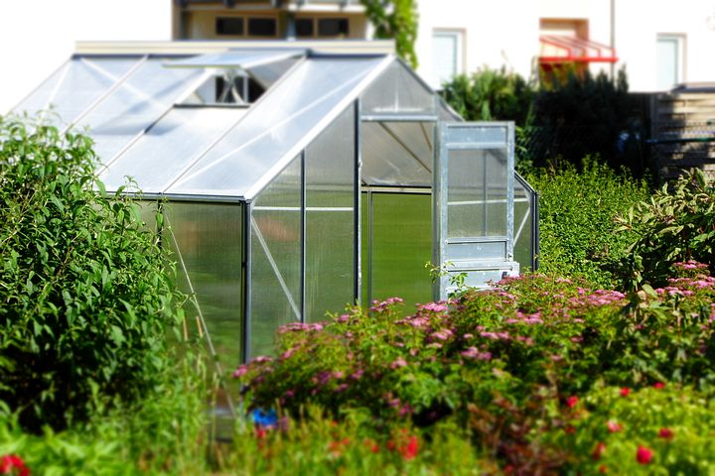
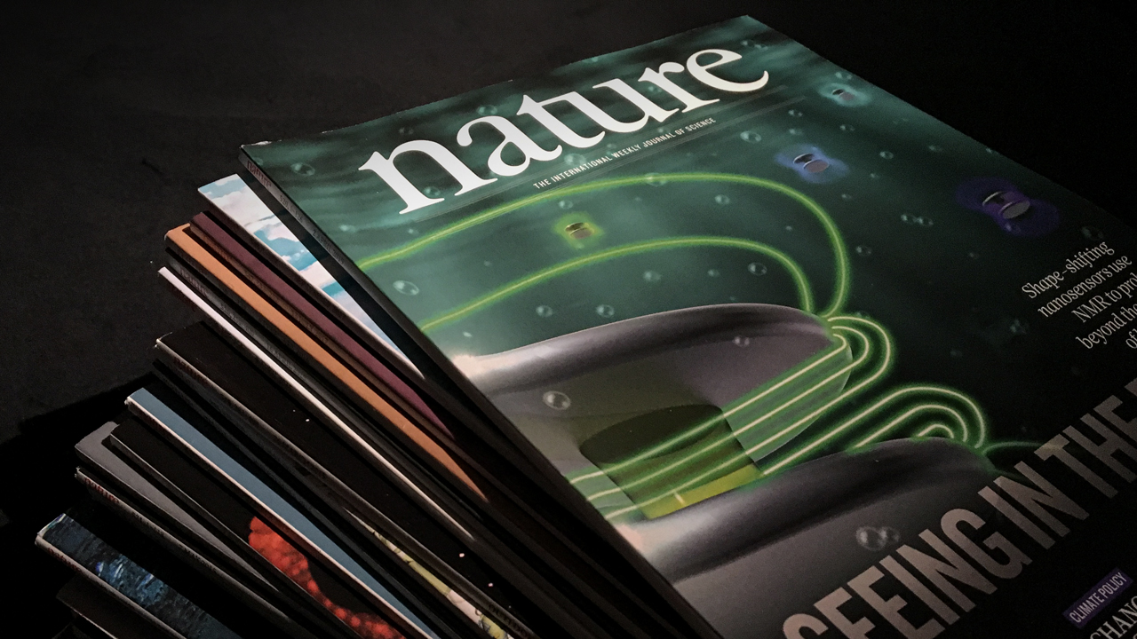
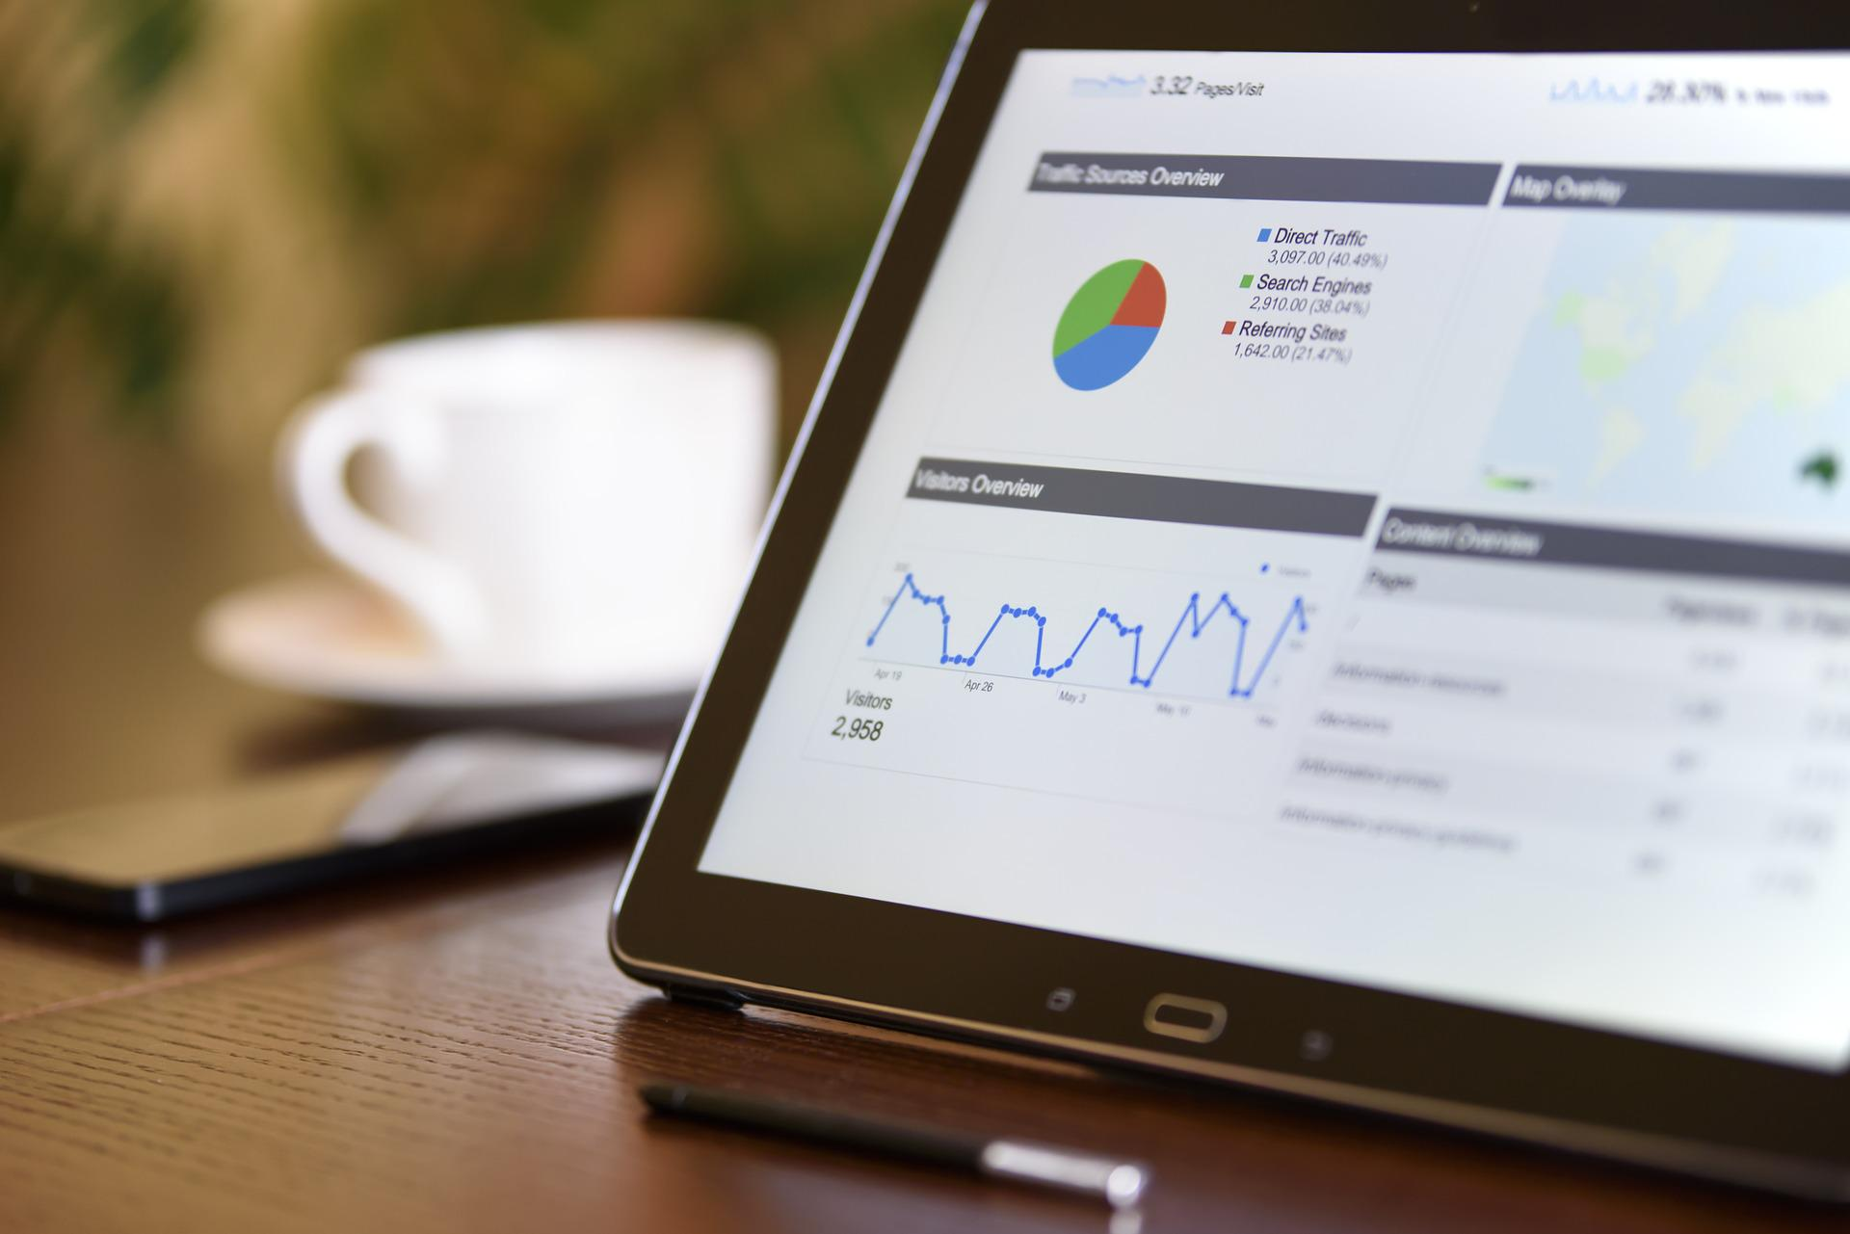
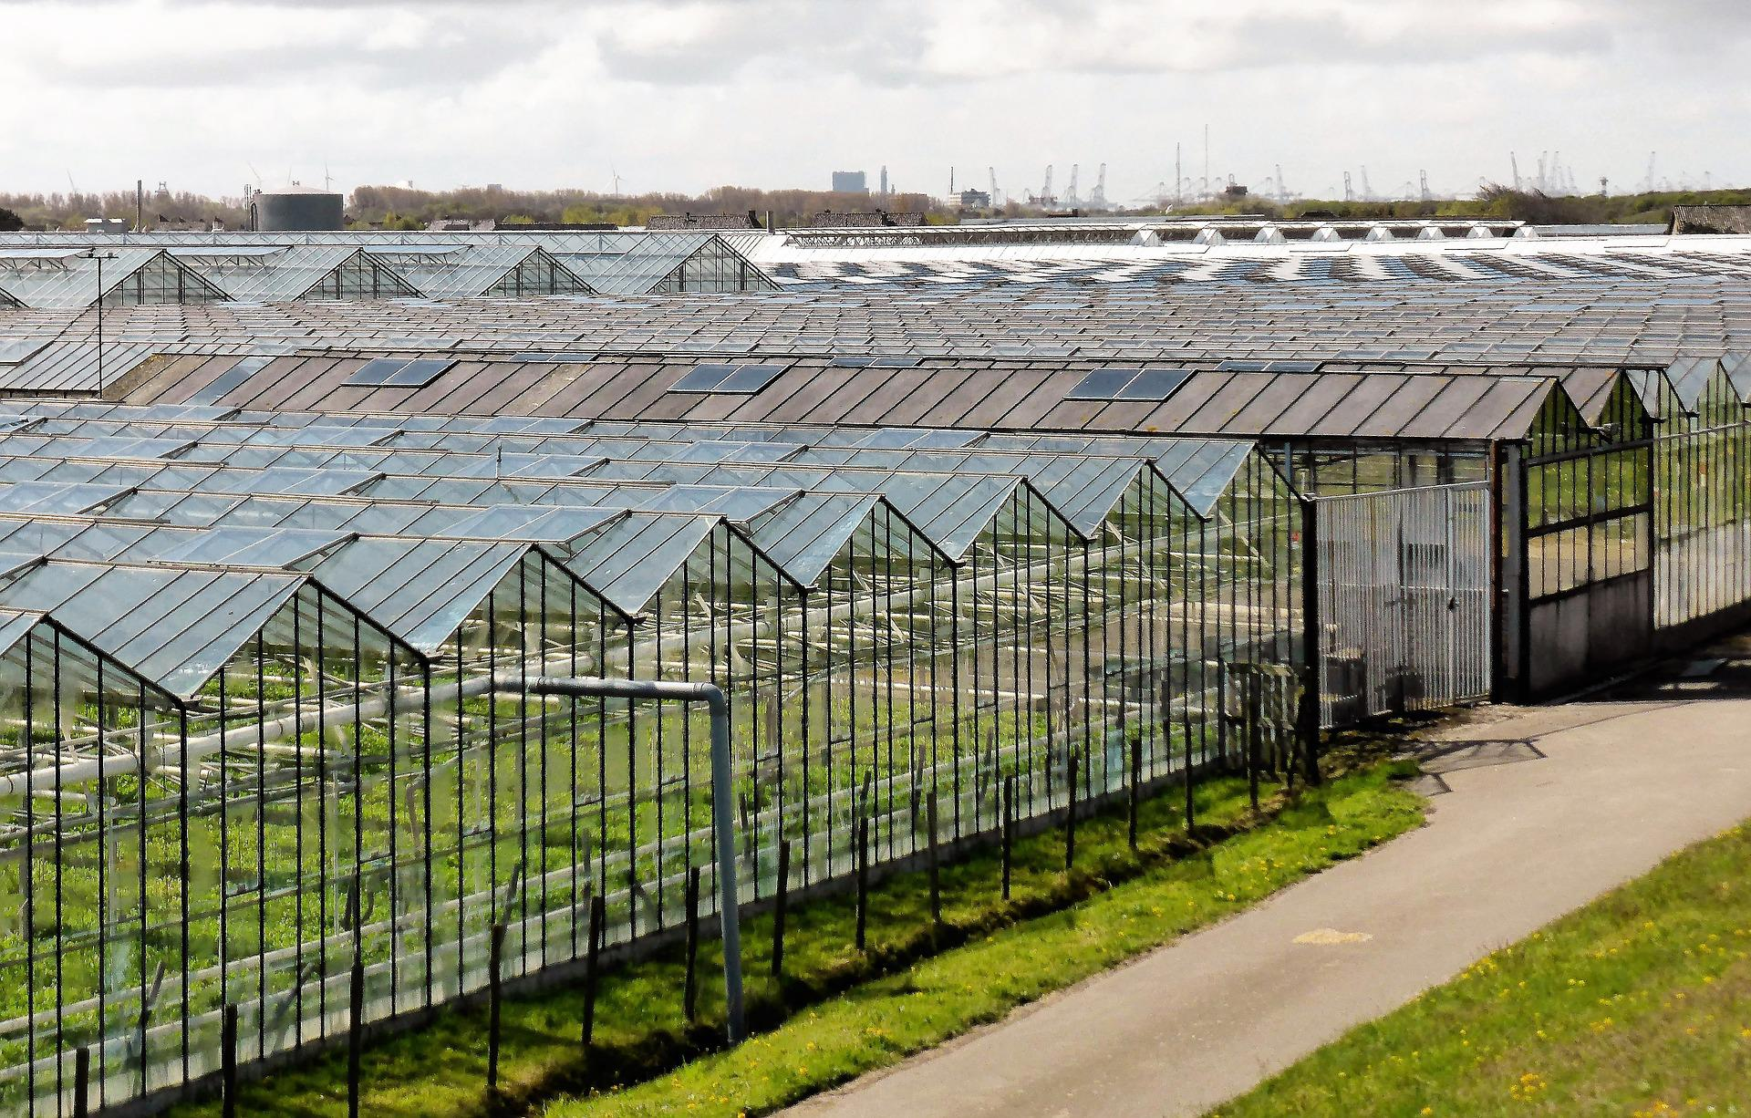
Navigating and Conquering the Market:
Using our experience in hardware electronics and full-stack web-development, coupled with our connections in the Midwest venture capital space, we aim to obtain funding and conquer our market with the following strategy.
Partnerships
Marketing
Retention
Expansion
Build an inventory of 10-15 devices and use University of Minnesota agriculture platforms to partner with local small farms.
Gather results and user-insights from the soft launches and get featured in local agriculture journals.
Continue iterating the software and device to retain local farmers year-over-year and entice new customers to purchase the device.
Armed with testimonials and customer successes locally, expand to nation-wide journals to accelerate growth nationally and soon, globally.

Slide 13


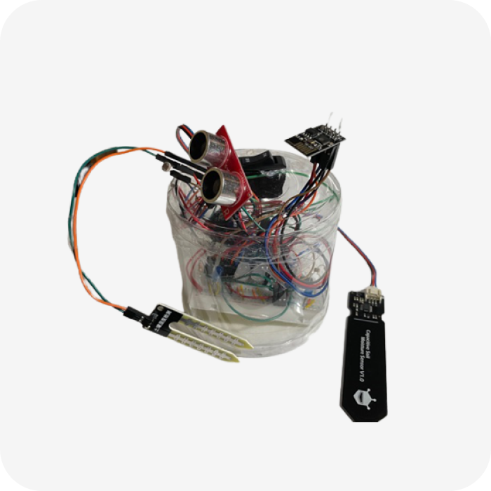
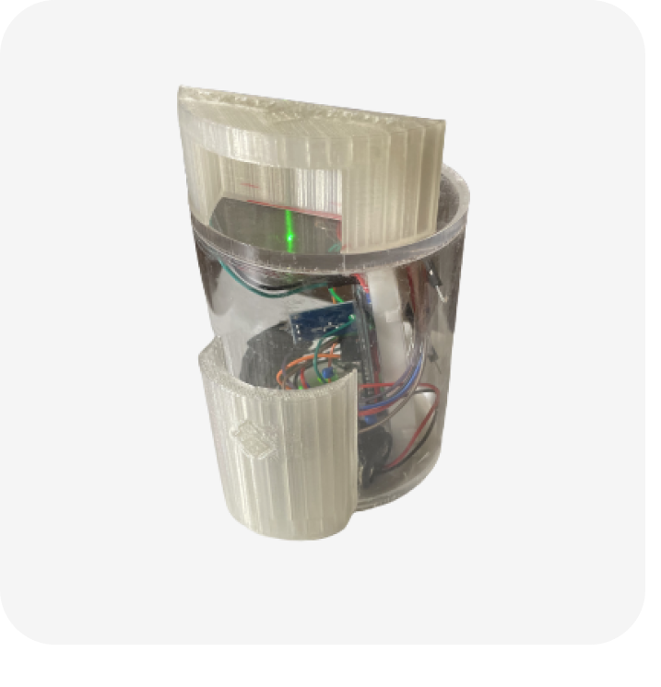

Current Progress.
Stage 1
Within the last 4 months, we have accelerated our business from a mere concept to developing a value proposition based on our market research. We have now completed an end-to-end platform to begin field-testing, with a small inventory of rugged wireless devices and a web-server that can support 500+ users.
March 15th
April 7th
April 24th
May 24th
June 15th
June 30th
July 15th
Market Research (Student Interviews)
Acquired web hosting & designed frontend
2nd in BizPitch Contest
Received $100 funding
Advisor joins team – assists in product angle
First prototype (indoor only)
Demo posted on website
Applied to MN Cup
Fullstack student joins team
Designed user-interface
Setup scalable server
Rugged device finished
Showcased at Minnedemo
Solar and low-power features added

Slide 14

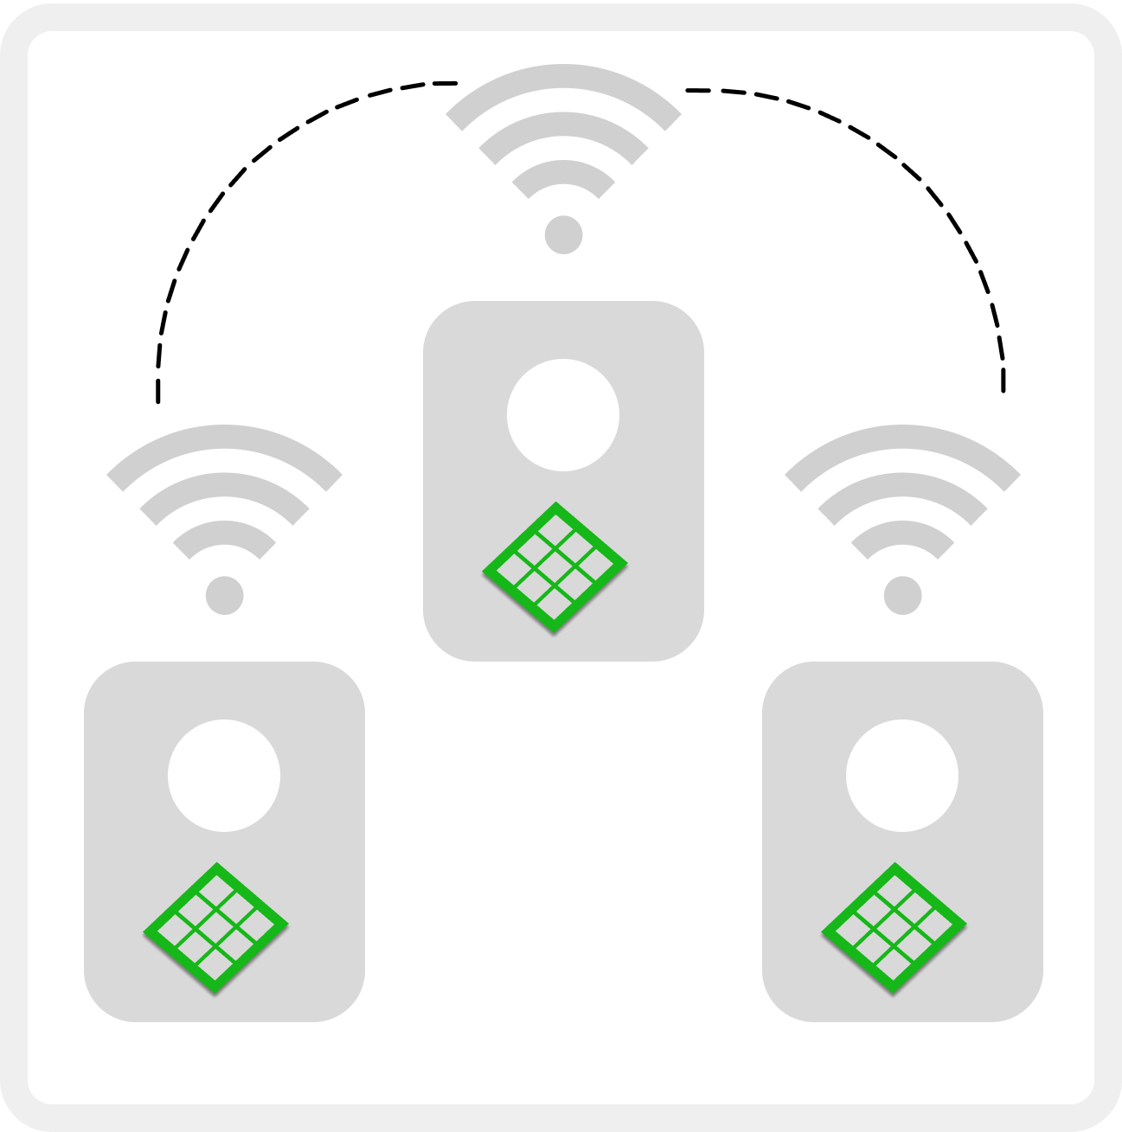
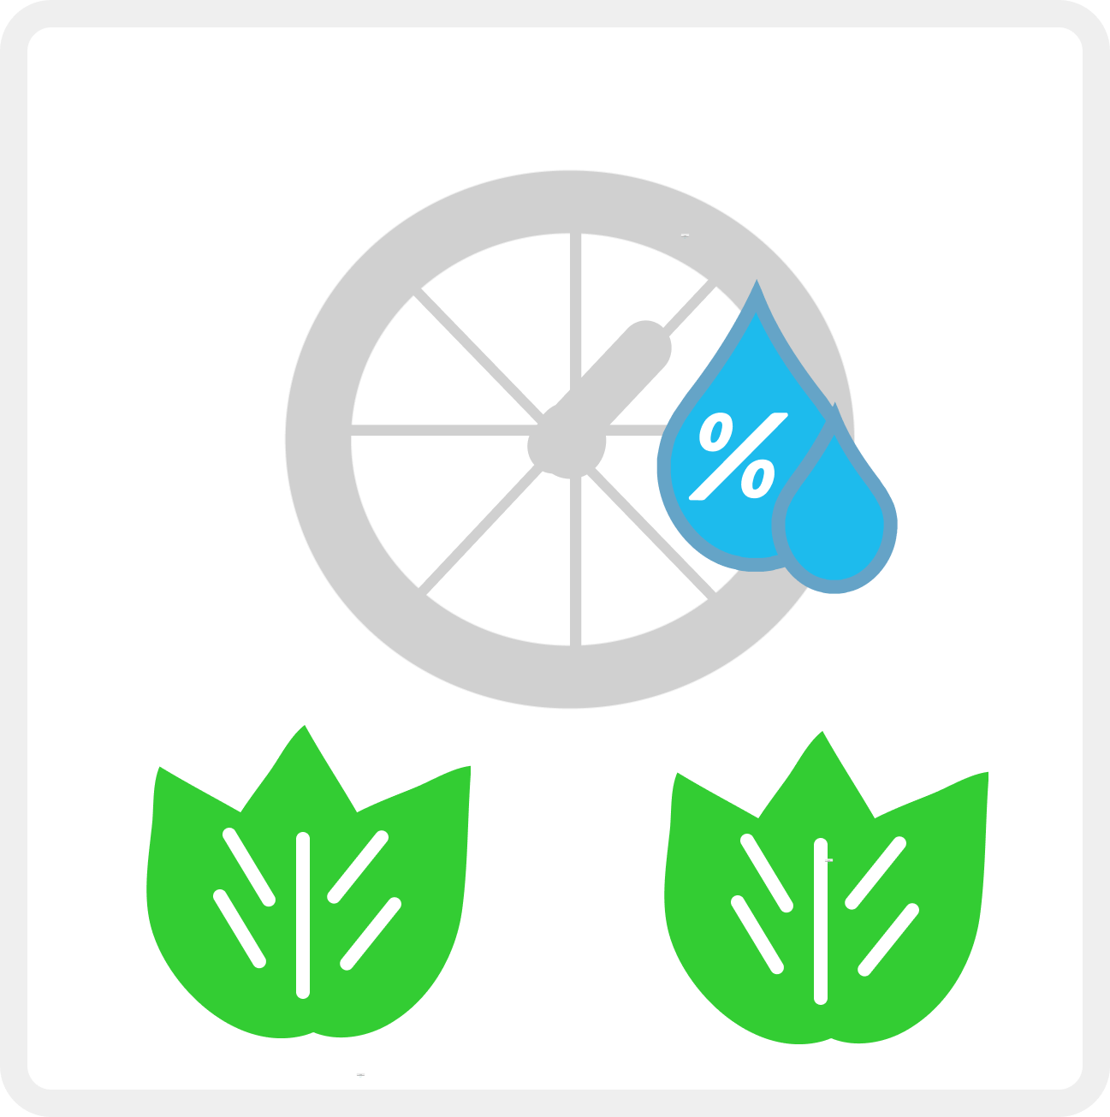

Marketing Strategy.
Stage 2
As students, we have access to a wide range of agriculture student group platforms at the University of Minnesota. In the next 1-2 months, we intend to use it to connect with farmers quickly and begin soft launches of our device at local farms.
To further exposure, we’ll collect performance metrics and testimonials to present in AURI journals – the largest agriculture research institute in Minnesota. Using this exposure, we’ll demo at large events and generate website traction, where we’ll advertise our testimonials and web-demo to close the sale.
Marketing:
Sales:
+
+
=
Demo (Website & Events)
Multi-site Tests
Collect Metrics
Advertise Results

Slide 15

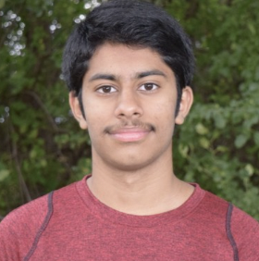

Team:
We are a strategic mix of software, hardware, full stack, and business planning experience. With the advising of mentors experienced in startup growth and management, we are well-equipped to tackle our problem and distribute our solution to local farmers.
Aditya Prabhu, Founder
Tanush Nadimpalli, VP of Fullstack
Susan Otten, MBA, ABC
Advisor
Aditya Prabhu – Computer Engineering, rising Junior, and analyst at Atland Ventures. Responsible for product & hardware engineering, frontend and slides/logo designs, and business operations.
Tanush Nadimpalli – Computer Science, rising Junior, and full stack engineer at DataVant, a health data management startup near Silicon Valley. Responsible for database management and web server design.
Susan Otten, MBA – Advisor; Founder of IndieDoGood, a company teaming up with startups in successful inventory management, distribution, and growth.

Slide 16
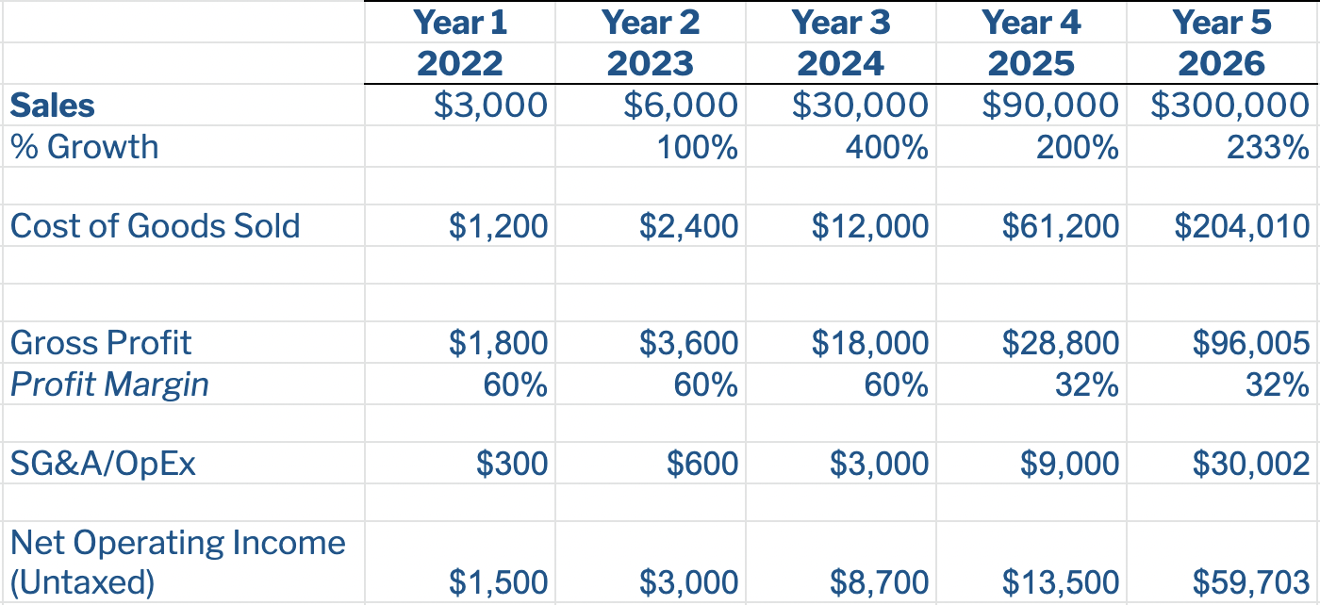
Financial Analysis – Key Highlights:
Given the most conservative estimates, our company is well on our way to generating revenue within the next year after field-testing and further market validation. Here are our key assumptions.
Total COGs $30/device, plan to sell retail for $50/device
Based on average farm-size and sensor placement intervals, we estimate $600 revenue average per farm
SG&A costs will be mainly incurred from Google Ads to generate website traffic. Assuming 15% conversion rate on traffic, our SG&A estimates are as follows to maintain the projected sales.

